Slide 1
Project 2 - Bayesian Networks
Bayesian Network for Stress Data (How Lifestyle Affects Stress)
Group #30 - Matteo Valente and Marcus Gee
Github Source Code

Slide 2
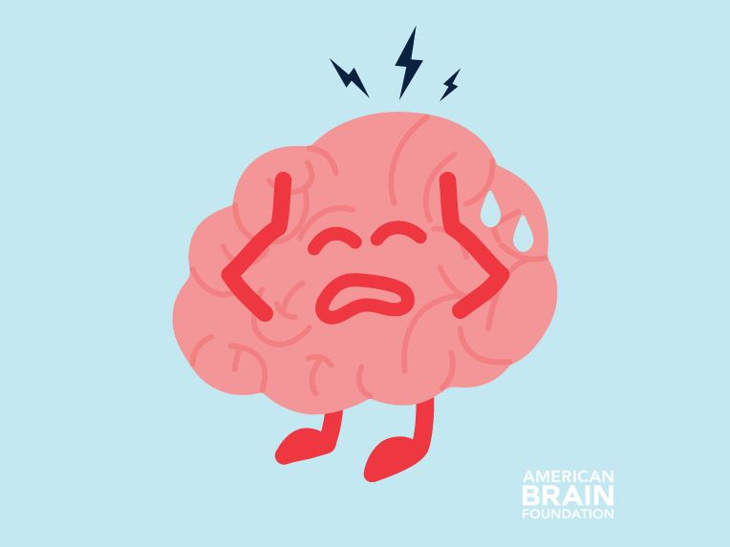
Stress
Life is inherently full of stressors, everything is interconnected
These can have major underlying effects on our health
The Average Engineering Student’s Brain 24/7
Notes:
Invisible baggage we carry everyday that affects our health

Slide 3
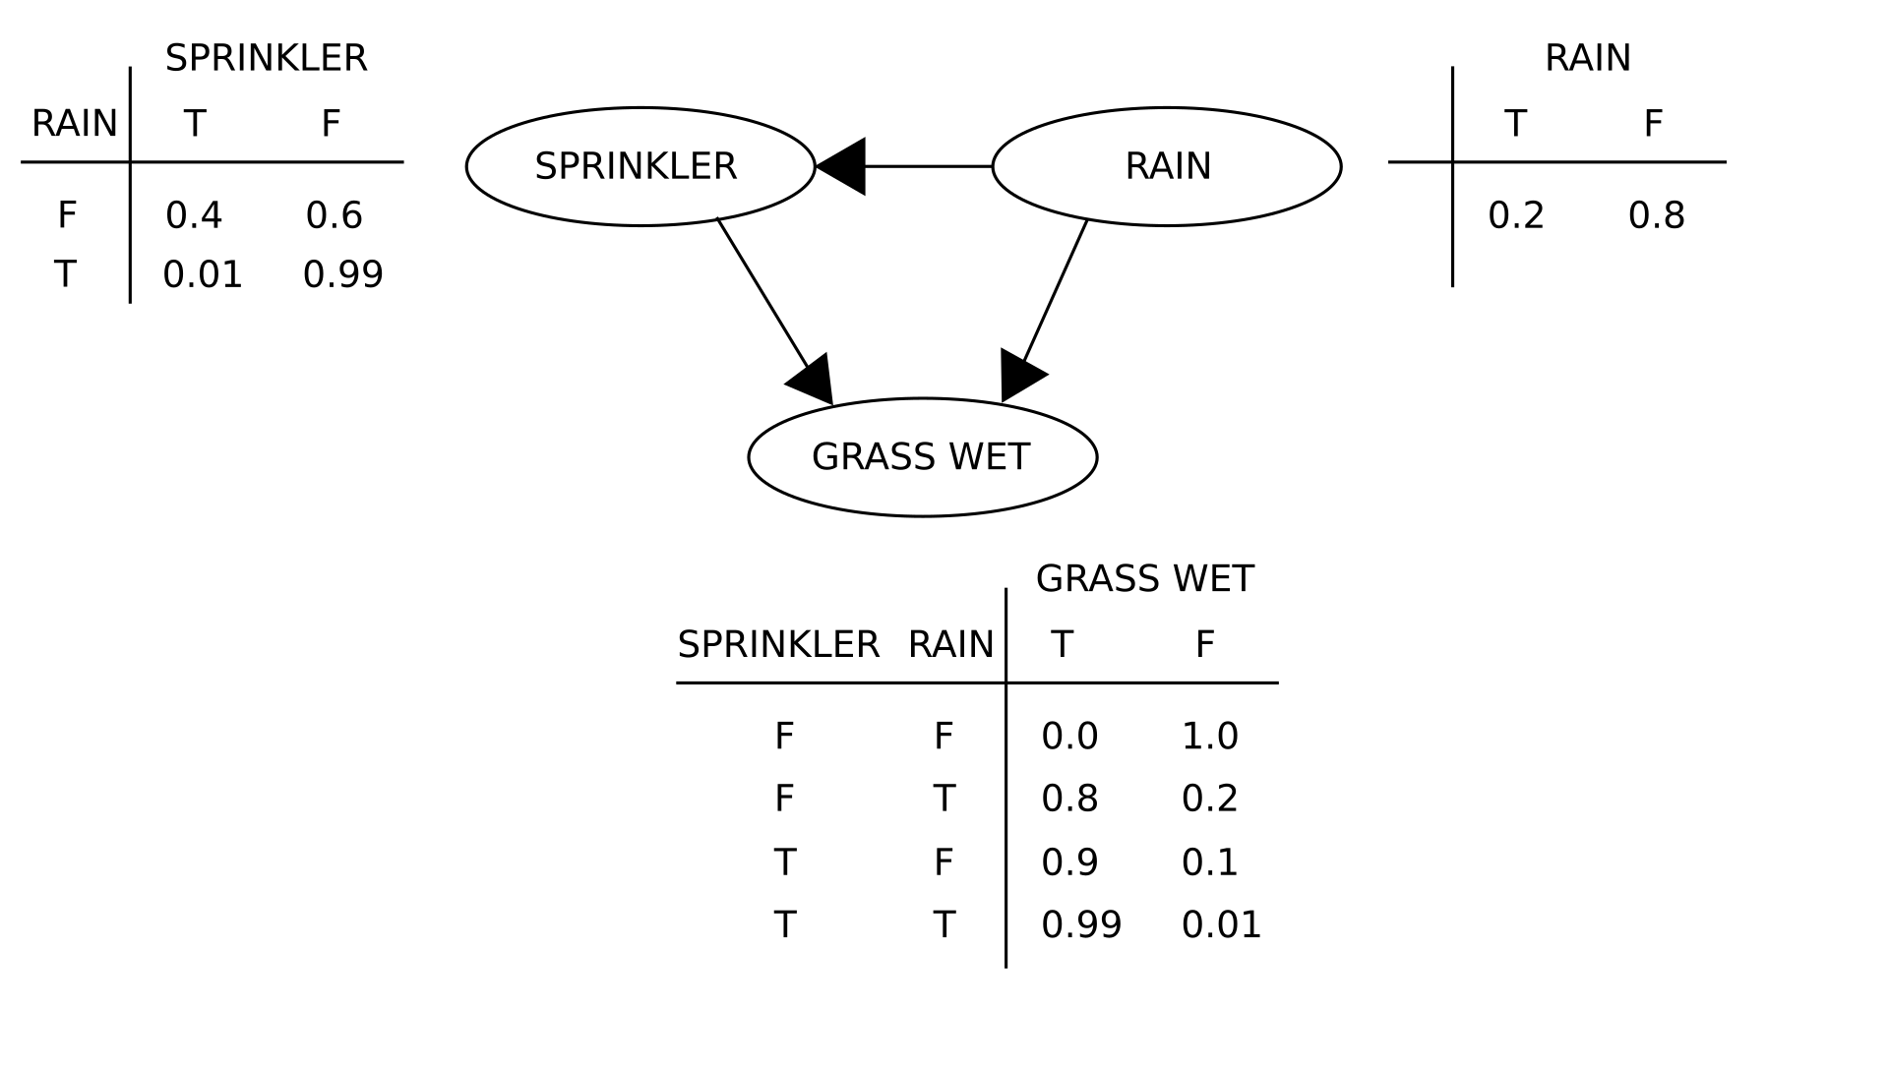
Bayesian Networks
We can use data to rationalize and understand our lived experiences
Bayesian Networks are a type of Probabilistic Graphical Model that can be used to:
Describe
Diagnose
Predict
An Example Bayesian Network

Slide 4
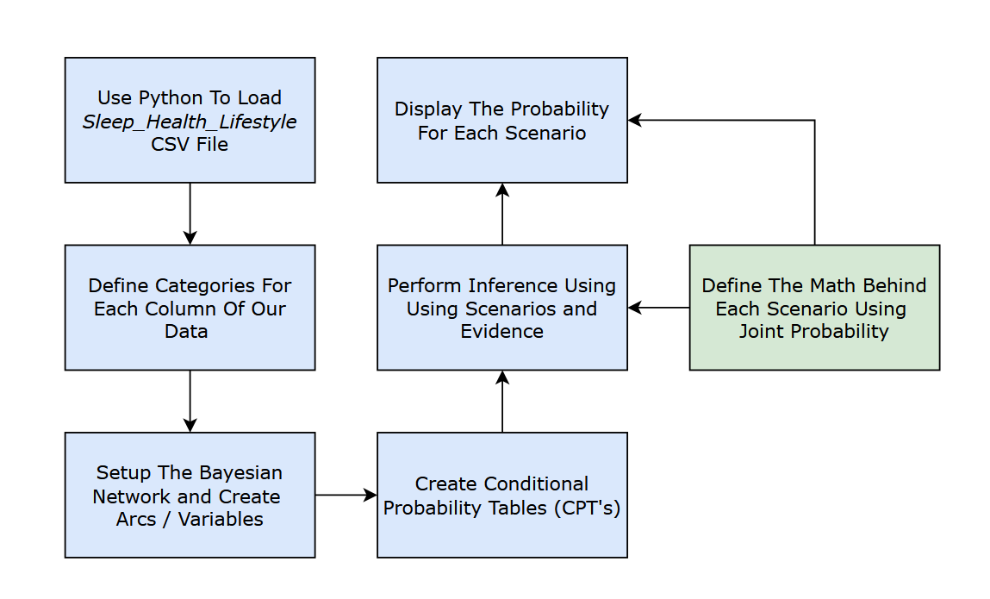
Procedure and Flowchart
Objectives
Build a Bayesian Network using real world data
Age
Occupation
Sleep
Physical Health
Compute Conditional Probability Tables (CPTs)
Analyze how lifestyle factors influence stress
Perform inference using different scenarios
An Example Bayesian Network

Slide 5
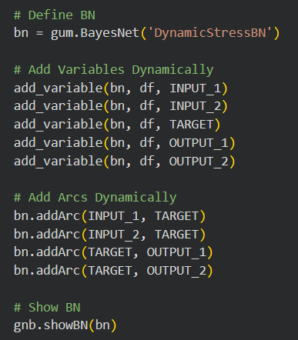
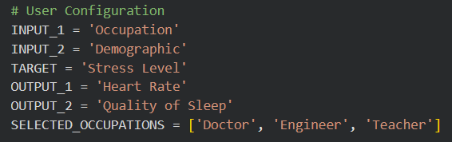
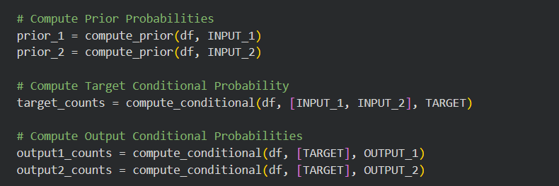
Bayesian Network Setup

Slide 6
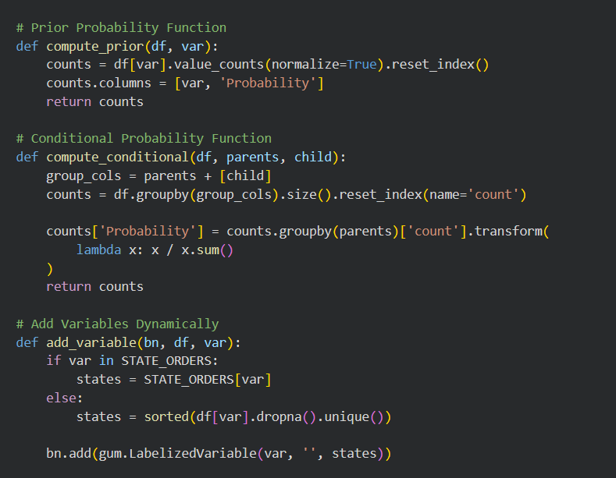
Bayesian Network Setup
Add Variable
Build the node with the appropriate name and ordered states, and then adds that new node into the network structure
Compute Prior
Counts how many times each unique value appears in the column and divides by the total row count
Reformats it into a clean, two column dataframe
Compute Conditional
Groups the dataset by the parent and child columns for how often specific combinations happen together
Divide the count of each specific combination by the total occurrences of the parent state
Fill Output CPT
Loops through every possible state of the parent variable of counts dataframe to isolate the probabilities for the child variable under that specific parent state.

Slide 7
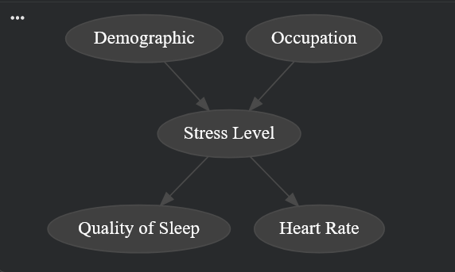
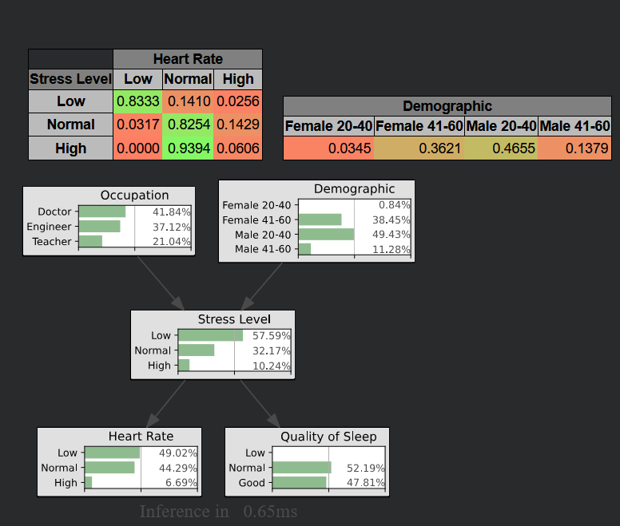
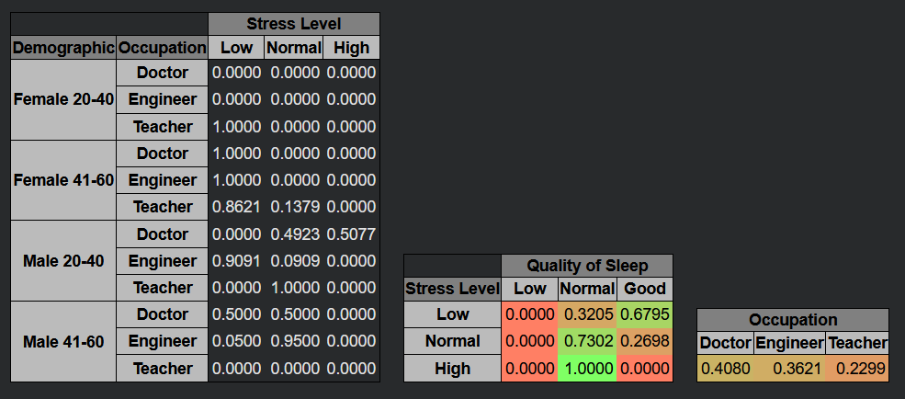
Bayesian Network Setup

Slide 8
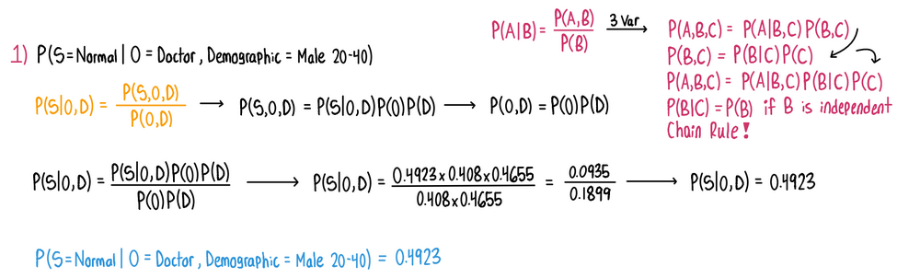
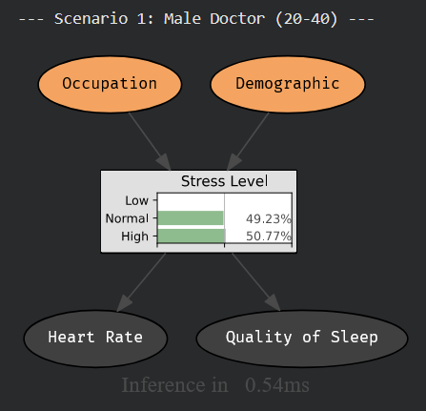
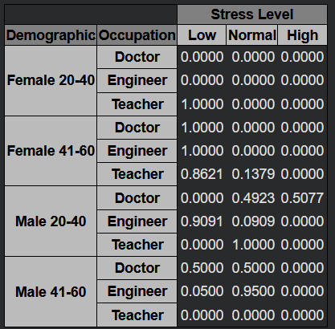
Scenario 1: Normal Stress for a 20-40 year old Doctor
Probability Stress is Normal given Occupation is Doctor and Demographic is Male 20-40

Slide 9
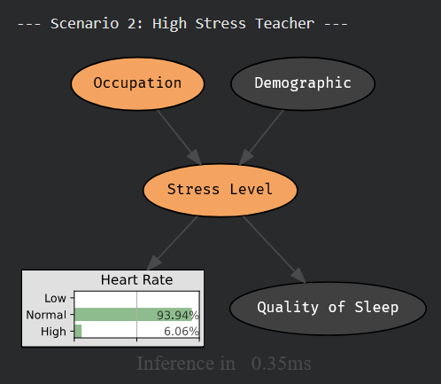
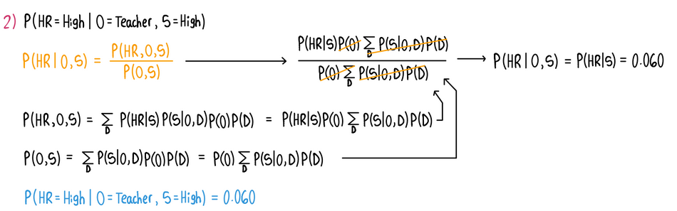
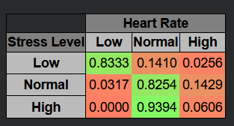
Scenario 2: High Heart Rate for a High Stress Teacher
Probability Heart Rate is High given Occupation is Teacher and Stress is High

Slide 10
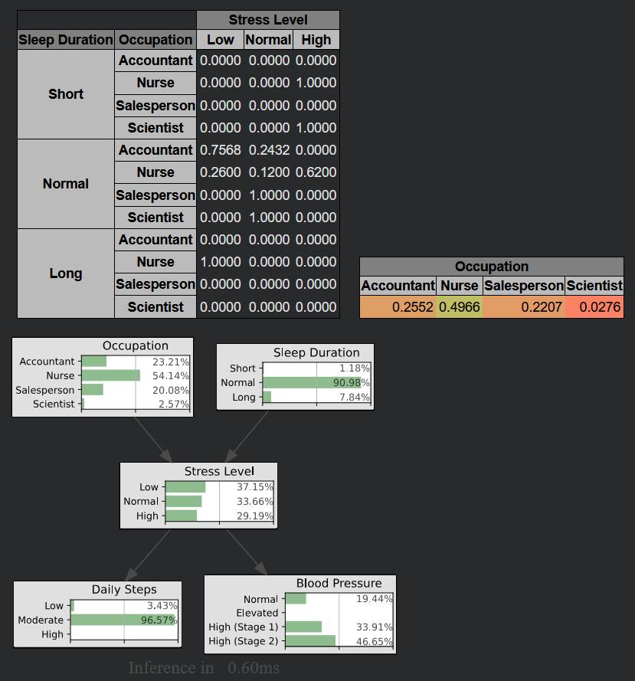
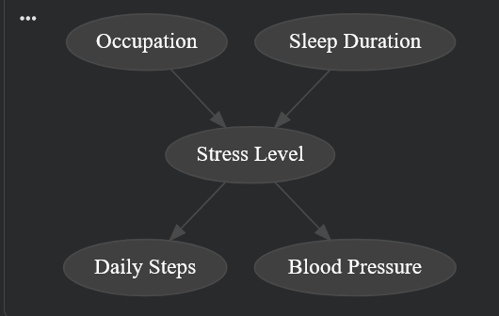
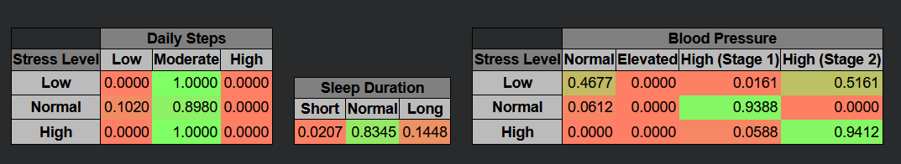
(New) Bayesian Network Setup

Slide 11
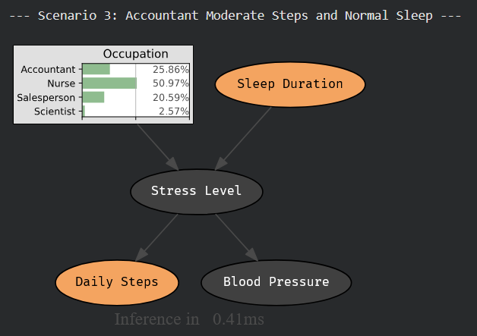
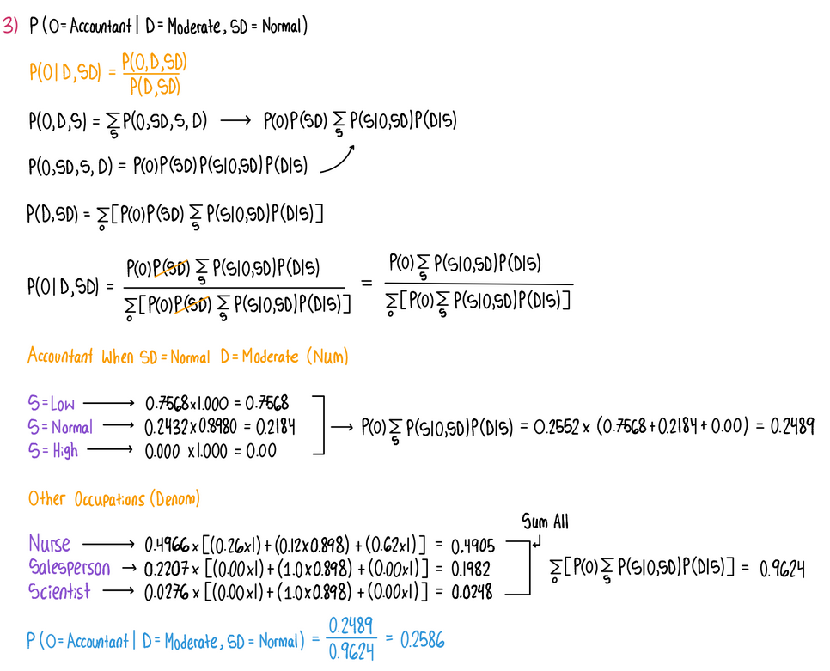
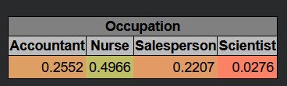
(New) Scenario 1: Occupation given Moderate Daily Steps and Normal Sleep
Probability Occupation is Accountant given
Daily Steps is Moderate and Sleep Duration is Normal

Slide 12
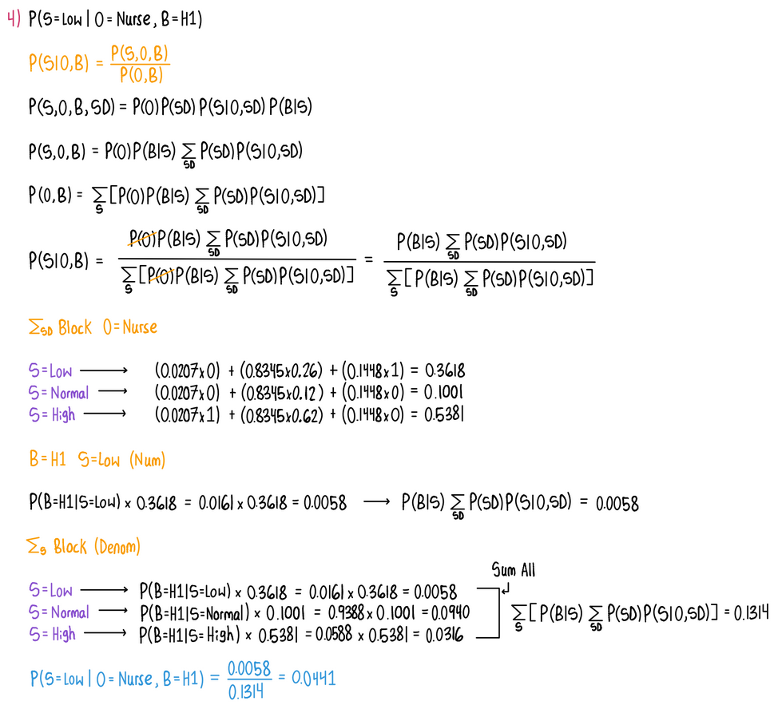
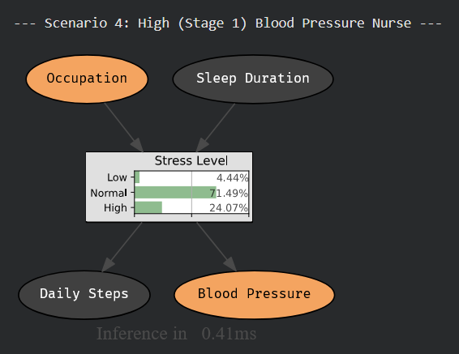
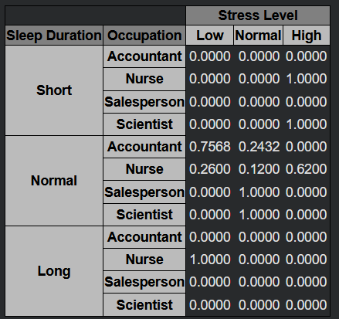
(New) Scenario 2 - Stress given a Stage 1 Blood Pressure Nurse
Probability Stress is Low given Occupation is Nurse and Blood Pressure is High (Stage 1)

Slide 13

Conclusions
Health and lifestyle are very interconnected
Bayesian networks allow us to model these relationships
In this investigation, we realized how much of an impact lifestyles have on stress and health
Take care of yourself!
Limitations:
The dataset we used could potentially have bias, for example, there were no doctors with high sleep scores
We only had 5 nodes in our Bayesian network, with so many factors we can easily miss relationships in data
The Average Engineering Student After April 30th

Slide 14
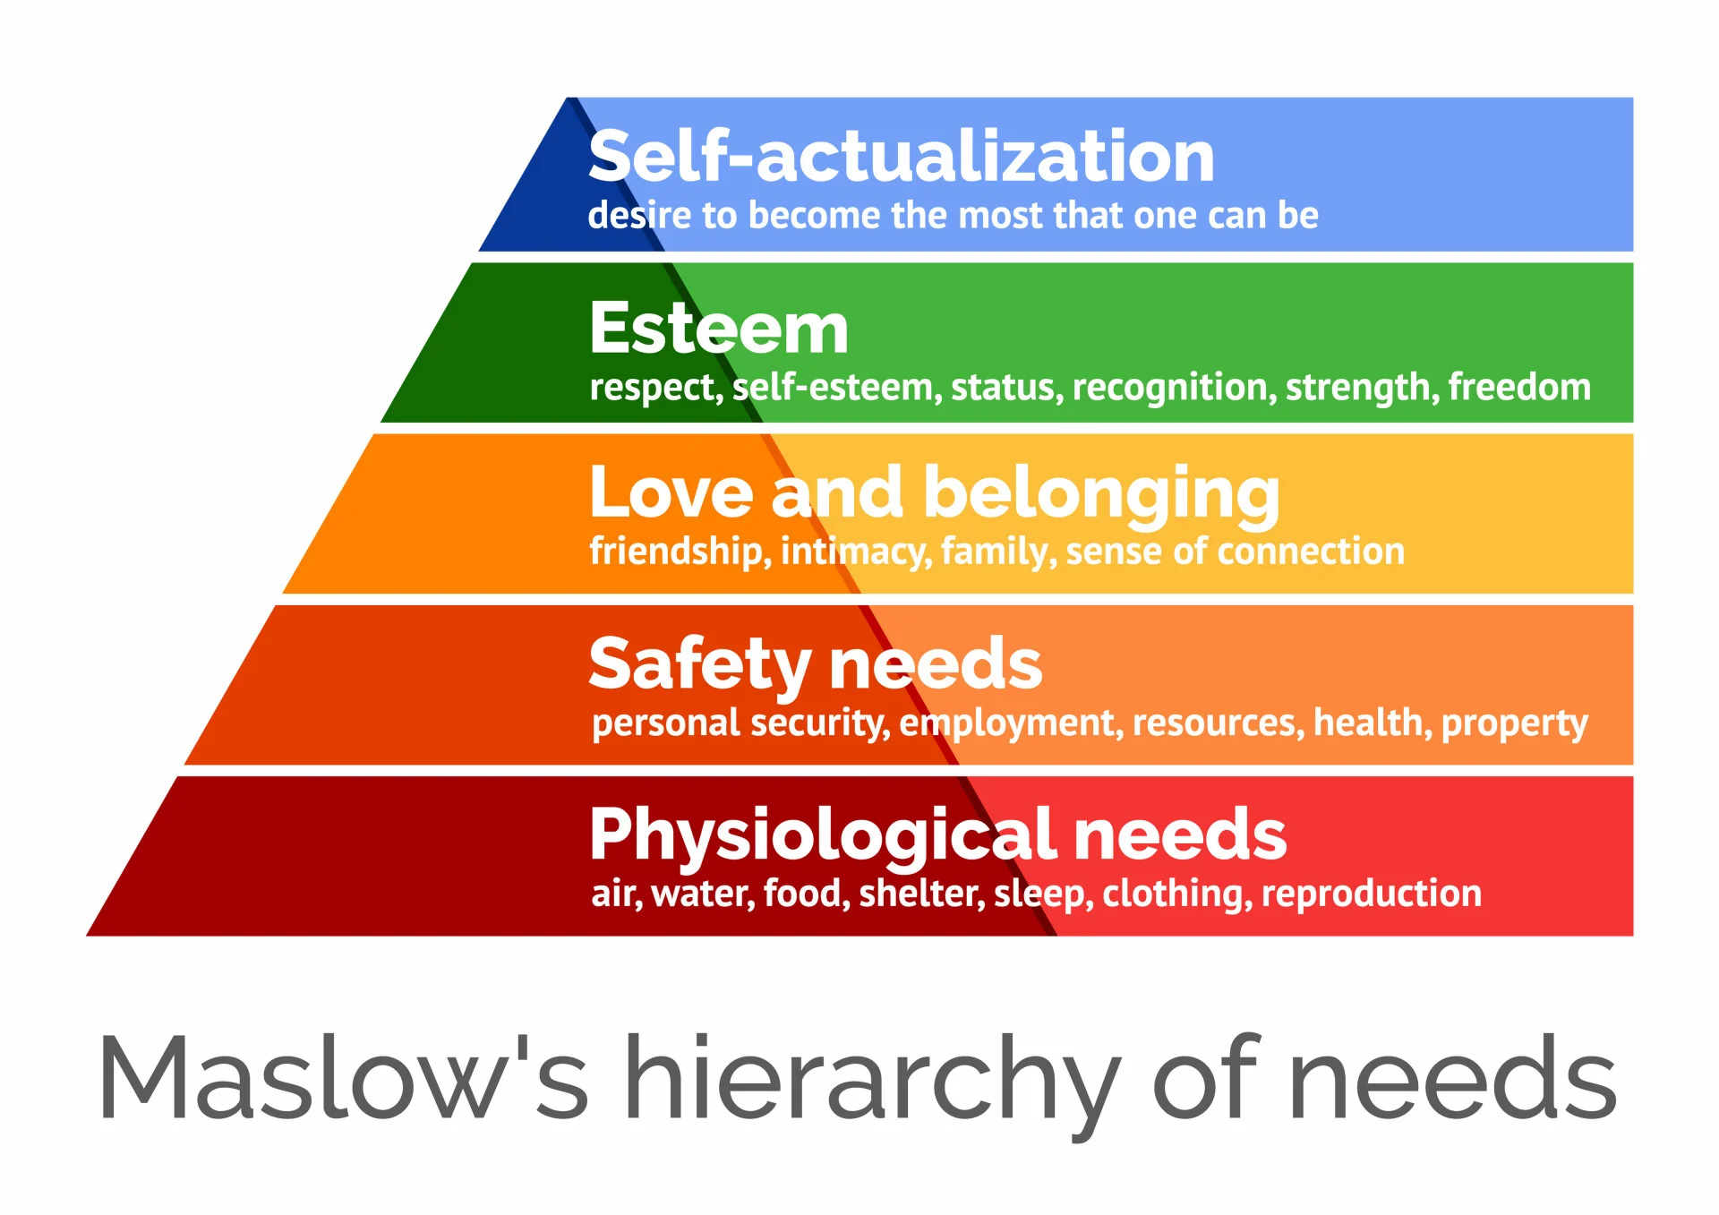
Future Steps
If we were to do this project again, we could look at additional variables, such as family structure, financial situation, or country of residence
We could expand the network to account for more variables

